Slide 1
2023 Street Program

Slide 2
Investing in City Streets
The City of Pottsville has 57miles of Liquid Fuel Eligible Streets
This number has increased over the years as streets become certified through the PennDOT review process
Since 2015, the City of Pottsville has invested 1.54 Million dollars in street paving and repairs
These funds were derived from Liquid Fuels funding, General Fund Budget Allocations, and Utility Partnerships

Slide 3
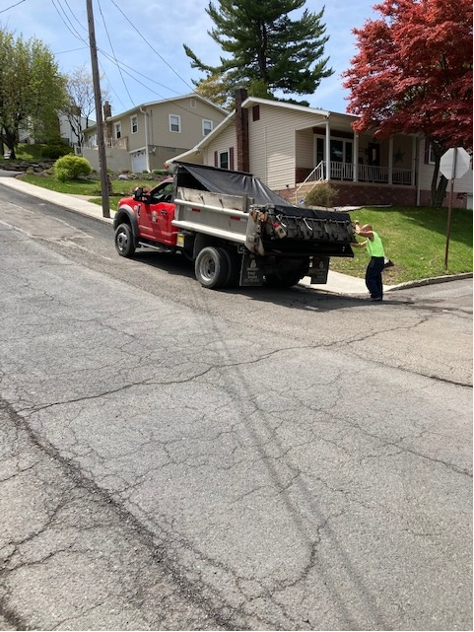
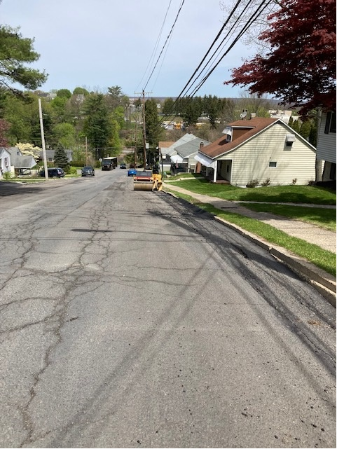
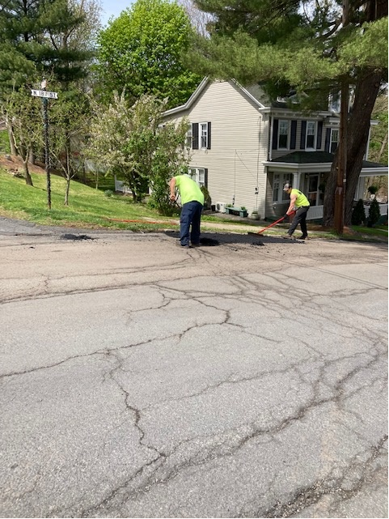
Investing in People
Hiring skilled workers and the provision of continuing education and training allows the City to maintain infrastructure in a cost effective manner. Our workforce completes the following:
Plowing, Paving, Painting and Cleaning street surfaces
Building and repairing inlets
Assisting with temporary and long term traffic control
(special events, signs, etc.)

Slide 4
Factors of Road Repairs
All Roads require regular repair and maintenance
Several factors impact the urgency and extent of that maintenance:
Utility Work/Construction
Aging Infrastructure
The Freeze Thaw Cycle
Use
Natural Disasters
Stormwater runoff

Slide 5
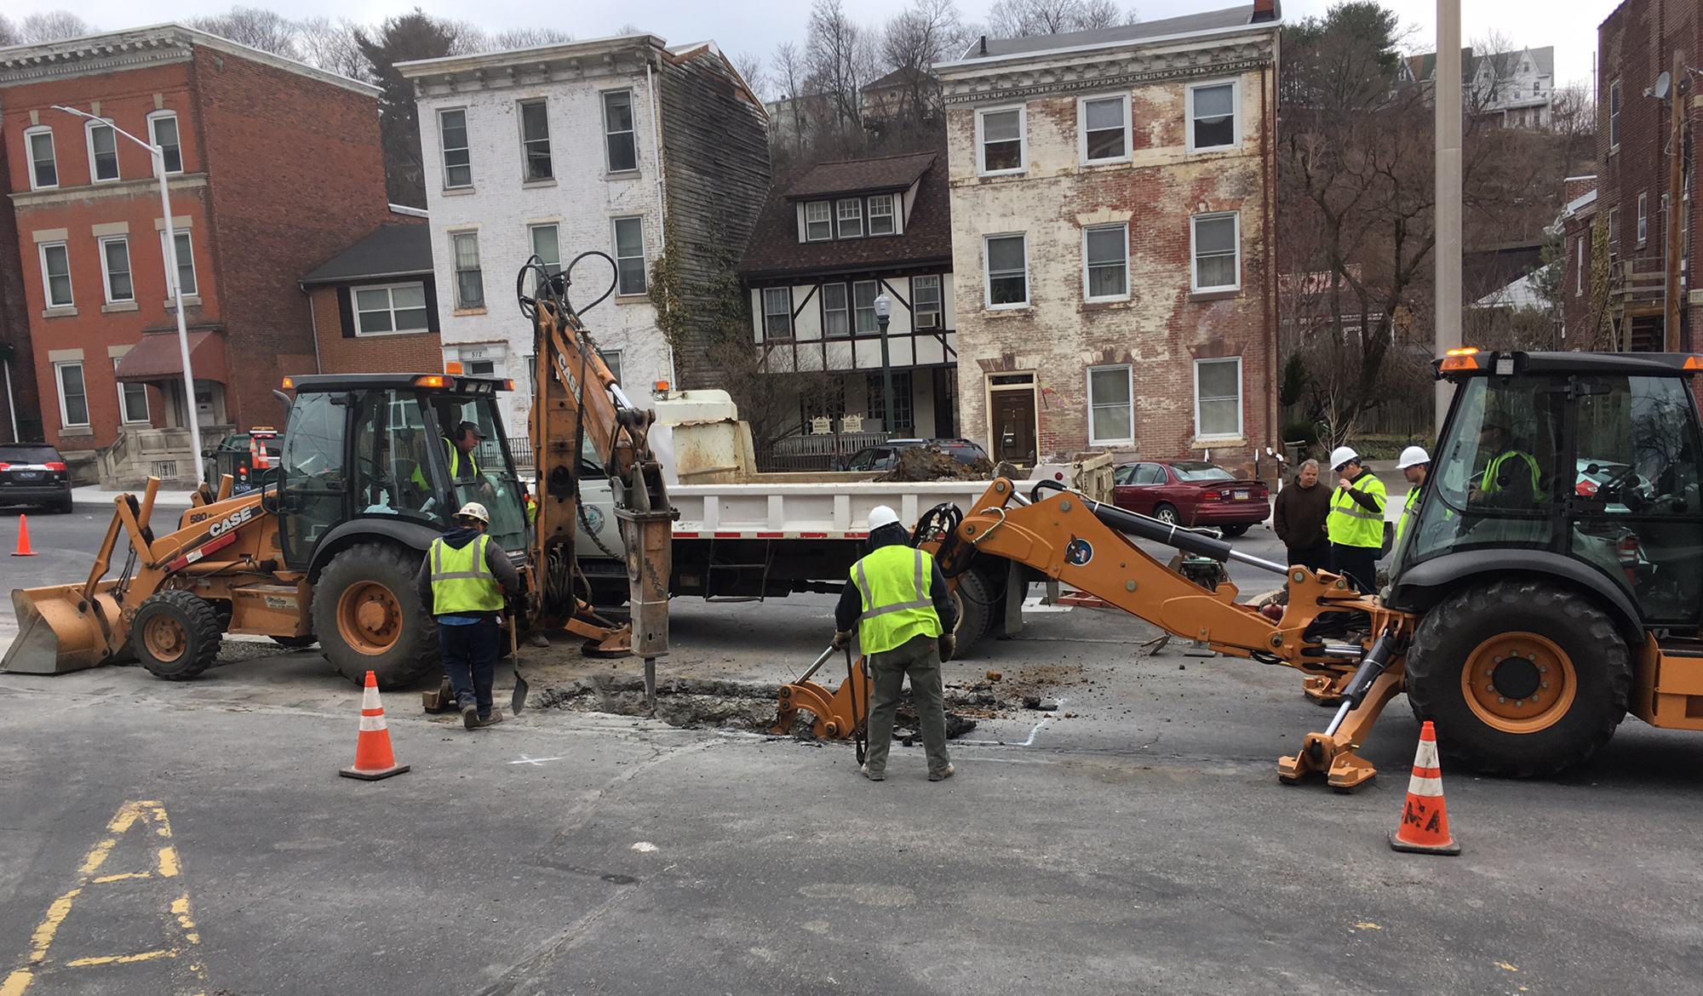
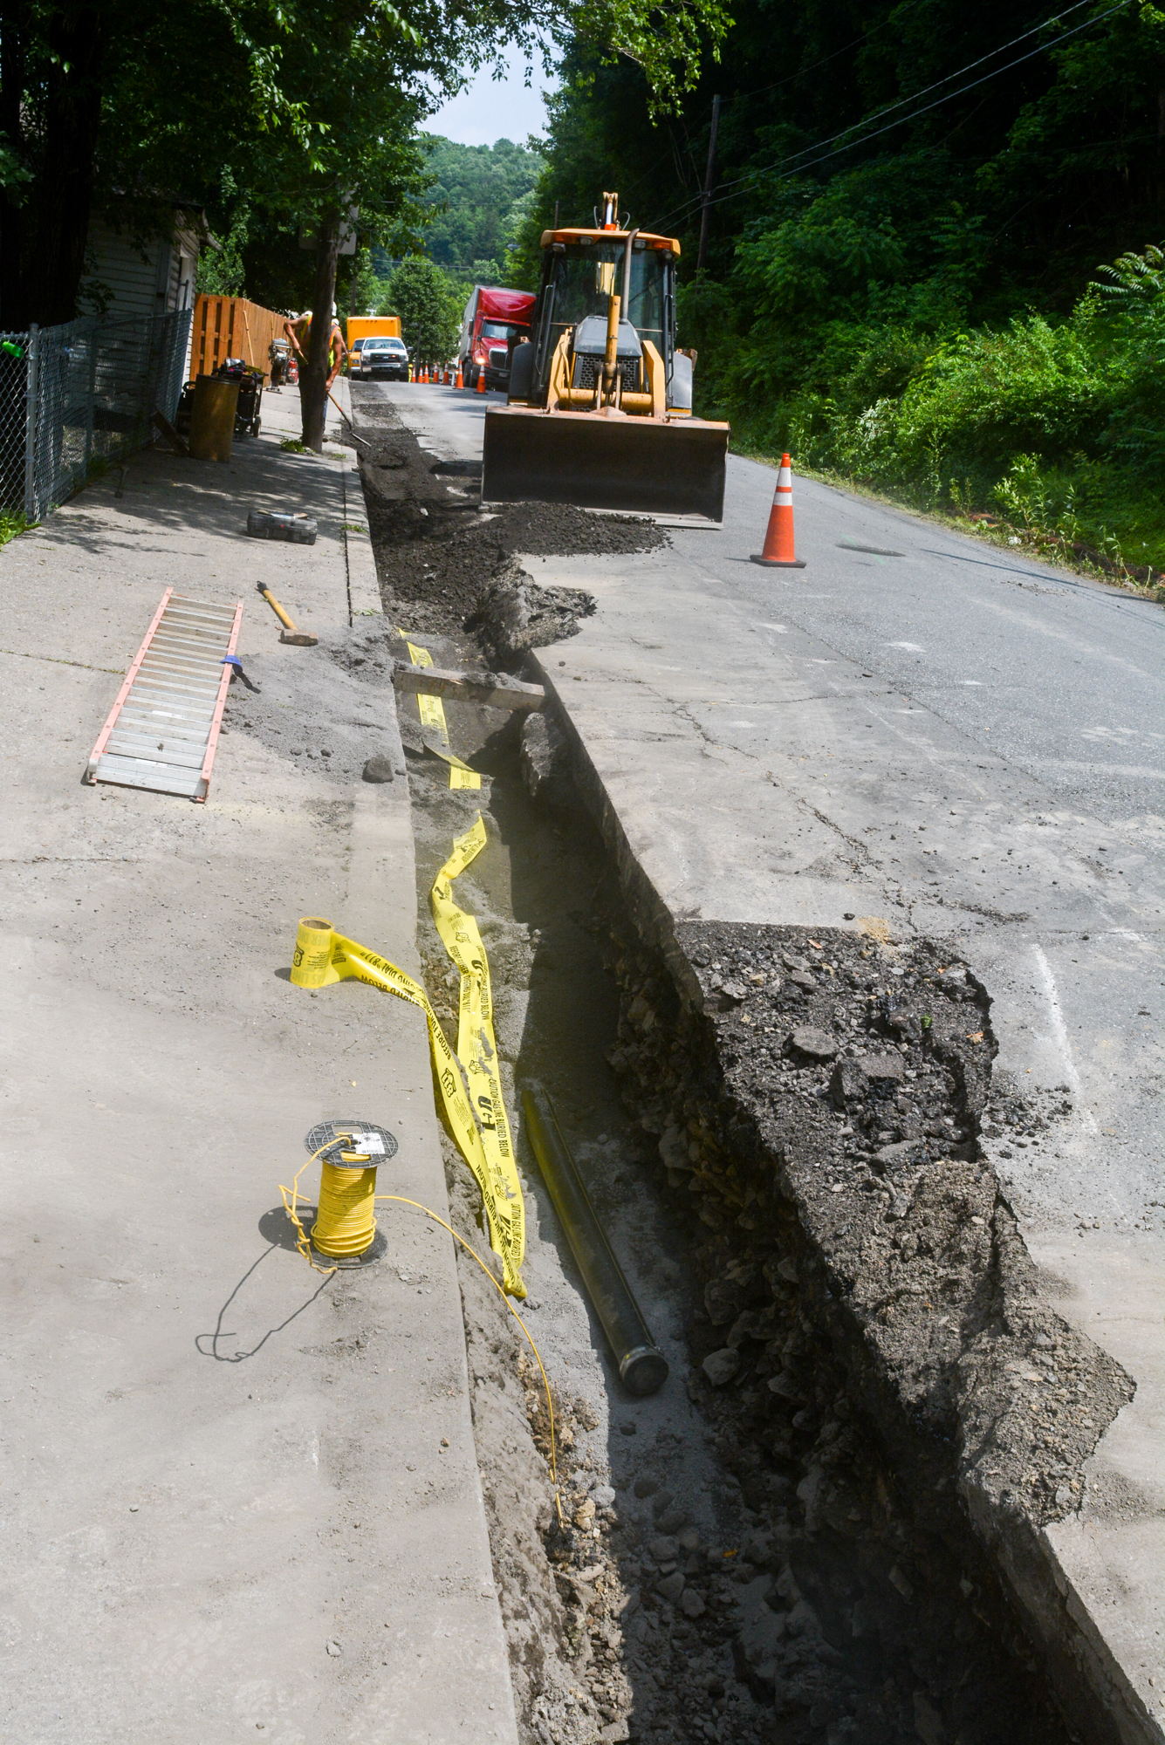
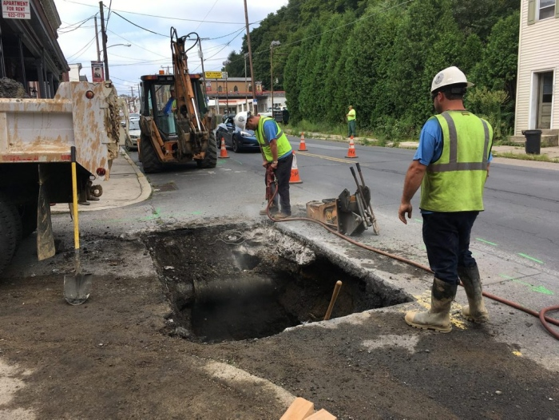
Utility Work
Utility upgrades and repairs are welcome and necessary. However, these initiatives can negatively impact driving surfaces.
Pictures courtesy of the Republican Herald

Slide 6
Who are our Utility Partners?
UGI Gas Utility – UGI continues to make significant infrastructure improvements in the City. The City has one of the most state of the art gas services in Pennsylvania.
Schuylkill County Municipal Authority (Water)
Greater Pottsville Sewer Authority
PPL Electric; Verizon
Utility upgrades include planned projects and work to restore streets in the aftermath of emergencies
Utility upgrades are vital in improving our quality of life and are crucial in long term community and economic development.
Communication and the development of effective working relationships

Slide 7
Working with Utility partners
The creation of effective partnerships with our utility providers is essential
The joint planning of projects enables all parties to make the most of each dollar spent
Short term / temporary repairs are essential to correct problems. In the winter months, this is particularly problematic because hot paving material are not available. In many instances these are the areas where drivers experience issues until more permanent repair can be made.
Ideally larger utility repairs can be properly planned if:
the disturbance is significant
the city and utility collaborate to share the cost of paving that is needed as assessing the cost to the city and utility as appropriate. Great examples include South Progress Avenue, Peacock Street, South 6th Street, Anderson Street, and Snyder Street

Slide 8
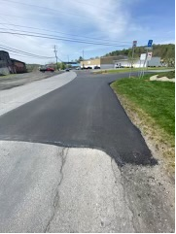
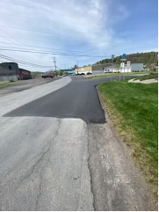
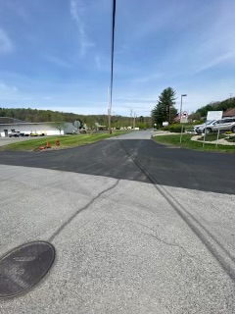
Working with Business partners
Developing effective relationships with business partners and investors is crucial in the planning and implementing of cost effective street improvements
Investors working in and with the City can significantly enhance property values, aesthetics, and public safety by implementing improvements around specific development projects.
The following picture shows a significant investment made by Miller Brothers, Inc. at the intersection of Woodglen and Westwood Roads

Slide 9
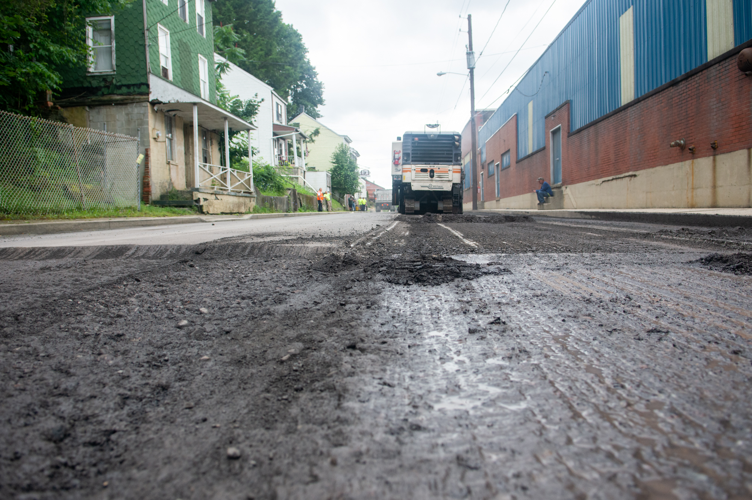
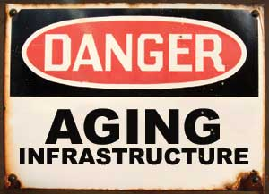
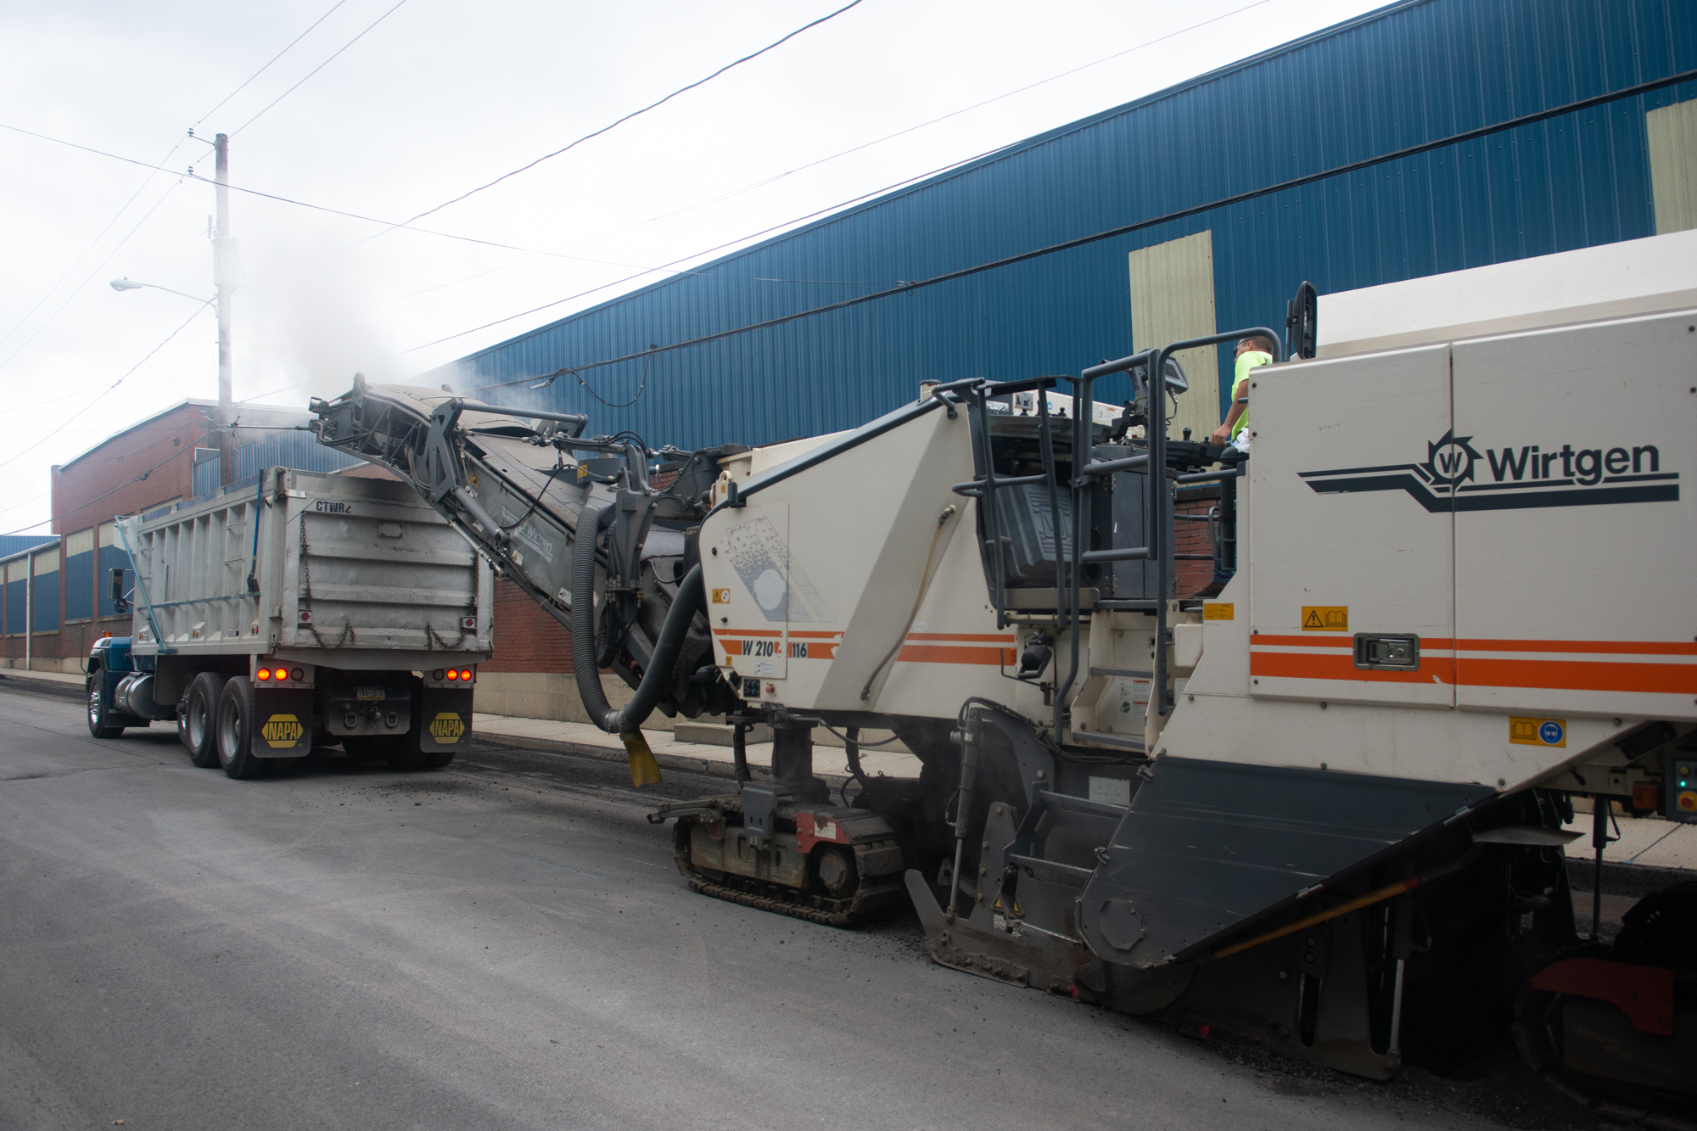
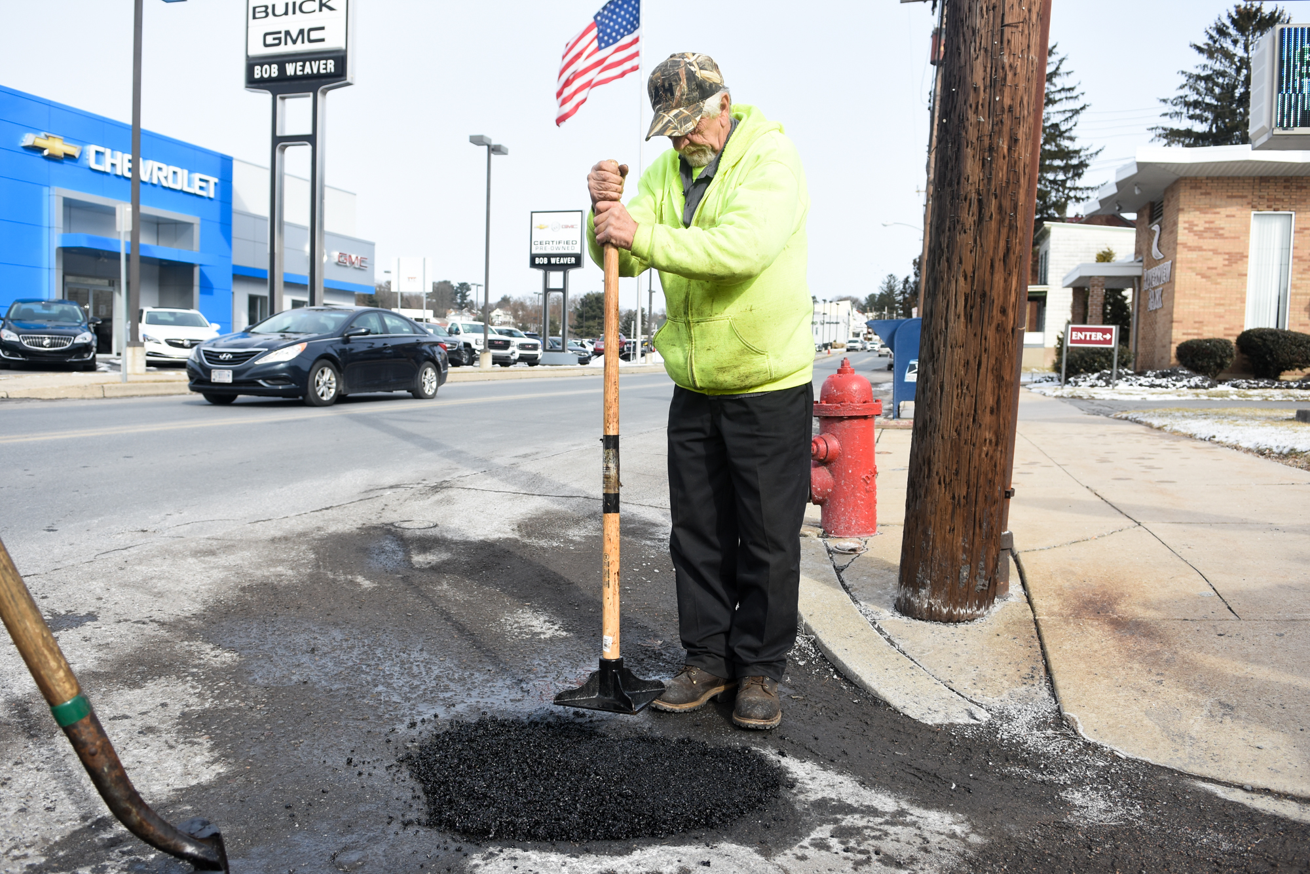
Aging Infrastructure
Pictures courtesy of the Republican Herald

Slide 10
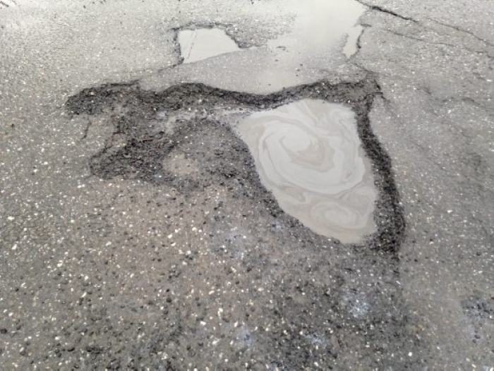
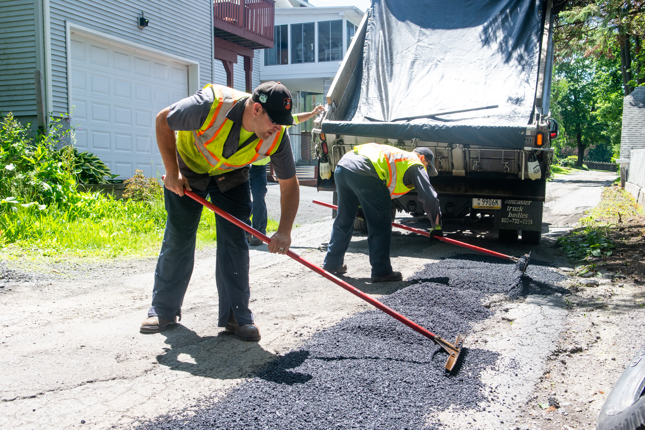
The Freeze Thaw Cycle
Water seeps into the soil and a road’s subbase below the pavement
Cracks or potholes in the pavement surface allow water to enter the paved area, this water freezes, expanding the damaged surface during winter months
During frigid temperatures, the water freezes and expands, pushing the pavement upward
As the weather warms, ice melts and forms cavities underneath, while the surface of the roadway remains elevated, cars travel overtop the cavities, crushing the compromised layer of pavement forming a pothole
Pictures courtesy of the Republican Herald

Slide 11
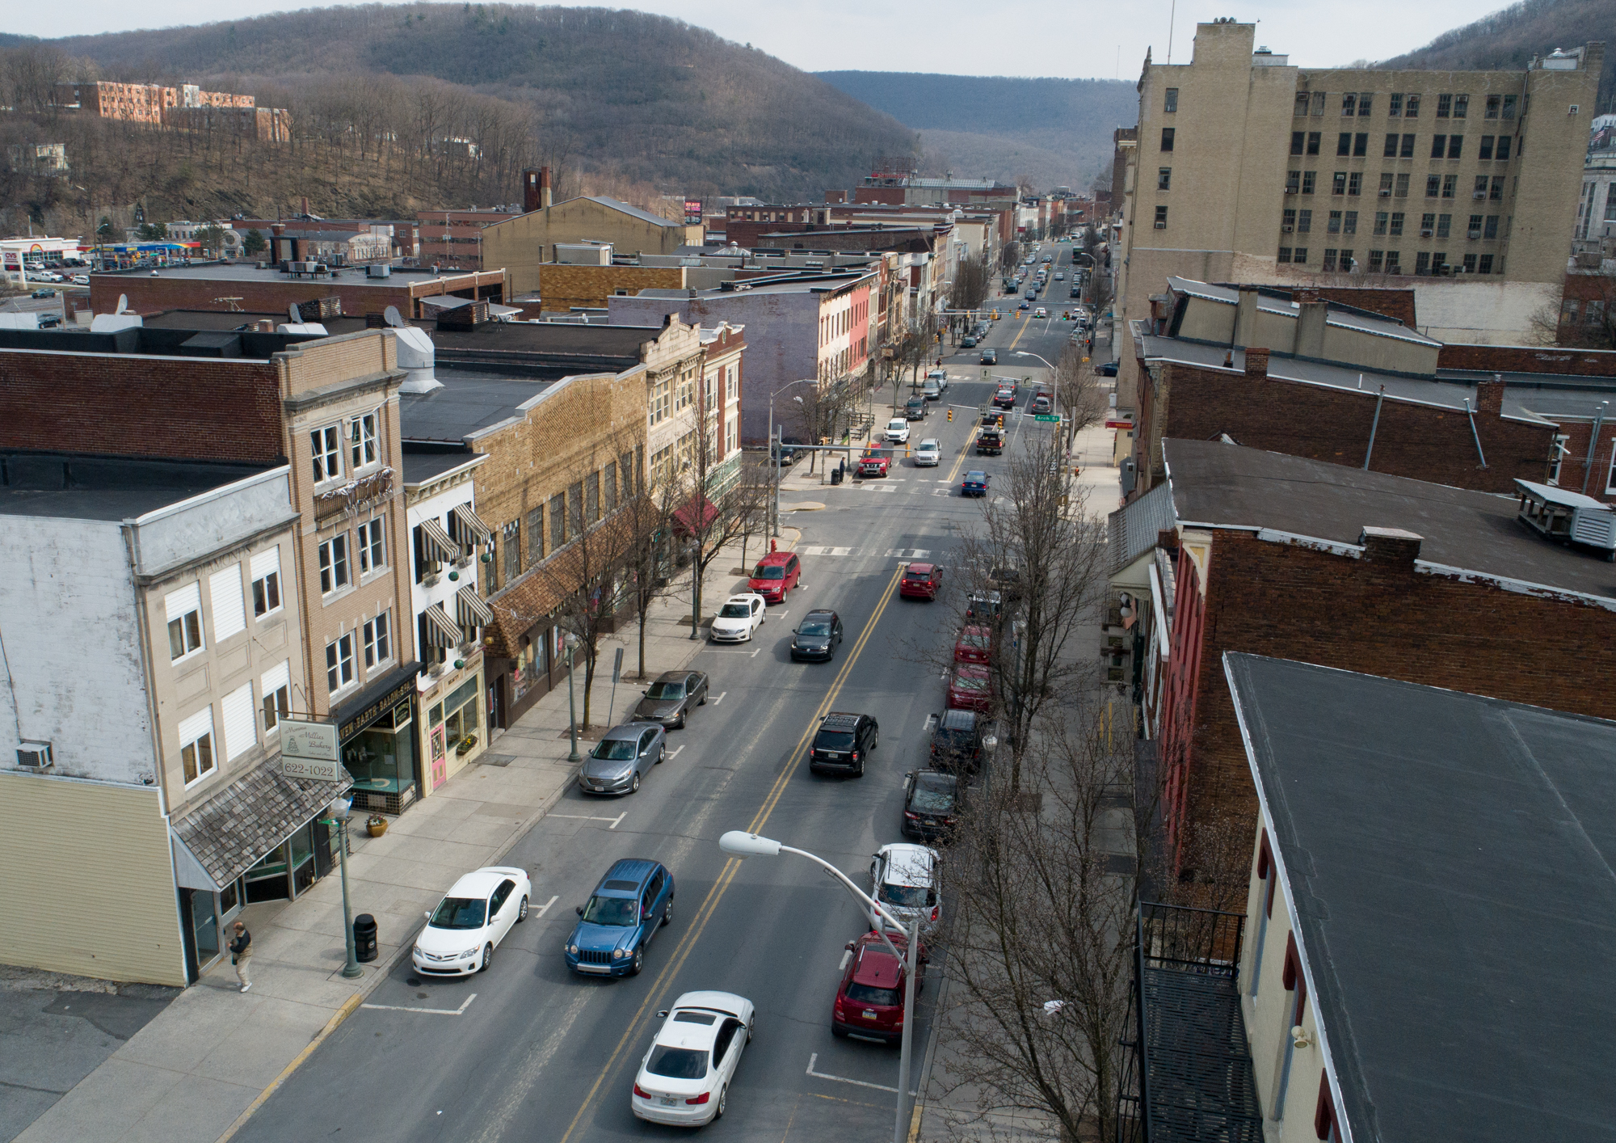
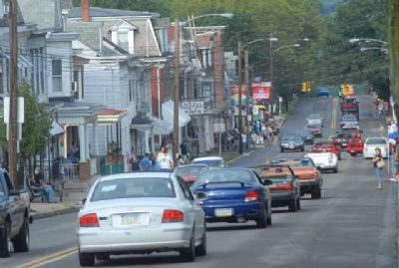
Use
Roads that are heavily traveled are at a higher risk of needing repairs and maintenance. Often times, they are the most expensive and difficult to repair. Tractor trailers and large vehicles are contributing factors to wear and tear on city streets.

Slide 12
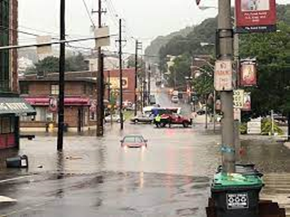
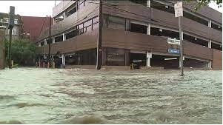
Natural Disasters
Damage from flooding, hail, strong winds can severely damage streets and public property. In some cases, city roads and infrastructure can be destroyed in hours.
In some instances, a federal disaster is declared and the city may be eligible for funding to complete repairs. If this is not the case, the City must make repairs as a part of our annual street improvements or contingency funding

Slide 13
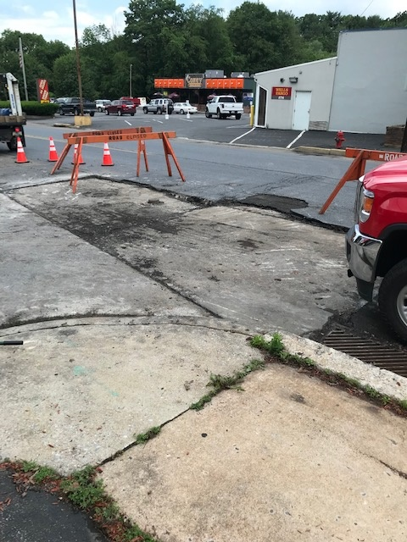
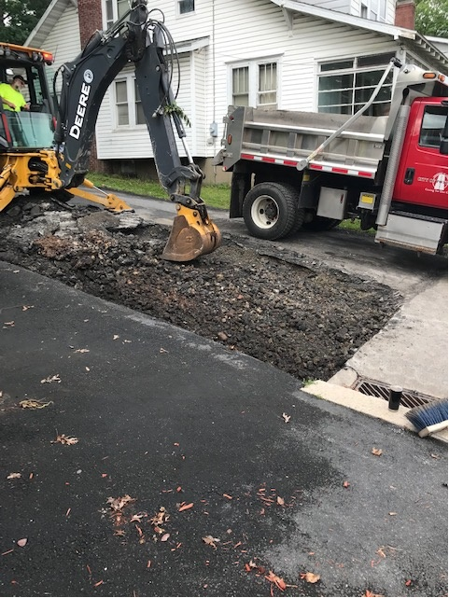
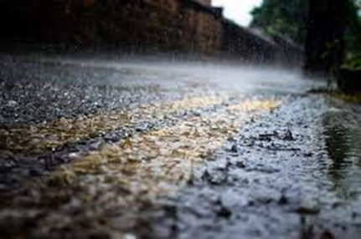
Stormwater Runoff
According to the US EPA, the average annual precipitation in Pennsylvania has increased 5 to 10 percent in the last century, and precipitation from extremely heavy storms has increased 70 percent in the Northeast since 1958.
The city is the early stages of creating a more formalized approach to manage stormwater. This is needed to mitigate the numerous street problems that are caused by constant and increasing stormwater runoff.

Slide 14
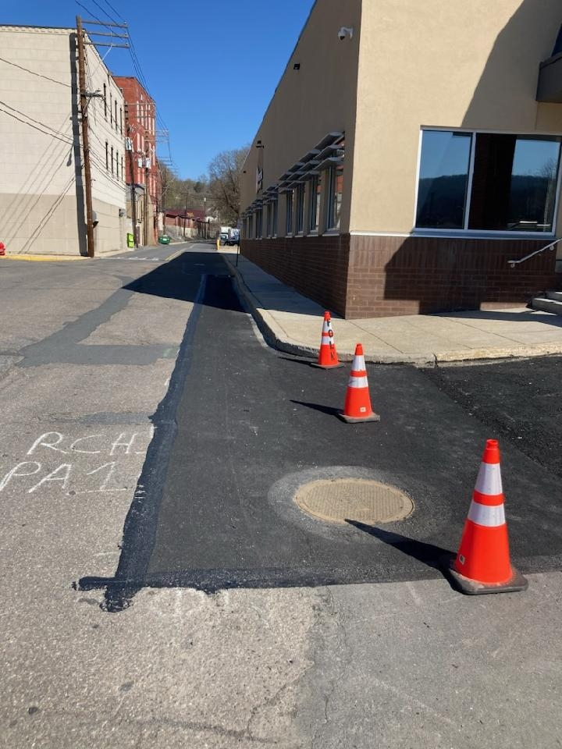
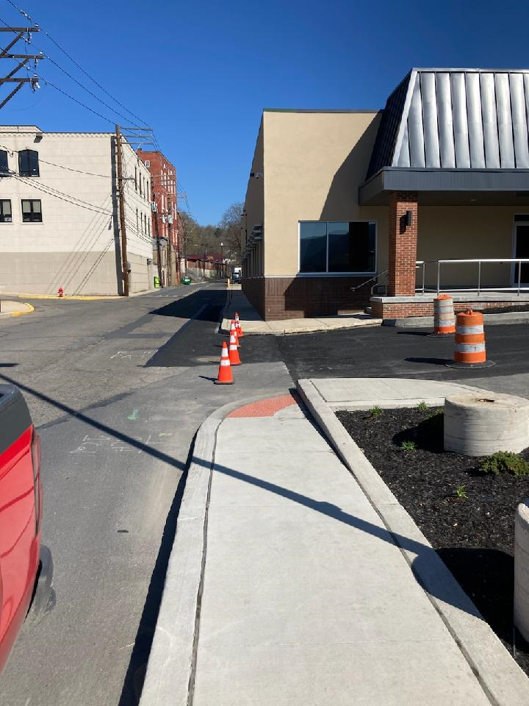
Working with Community Projects
Collaborating with a variety of city projects enables a variety of project to be completed in a cost effective manner.
A prime example would be working with Alvernia University in a stormwater management project that will redirect stormwater from their parking lot and Progress Ave into the stormwater management system. This will make the area safer for pedestrians and vehicles.

Slide 15
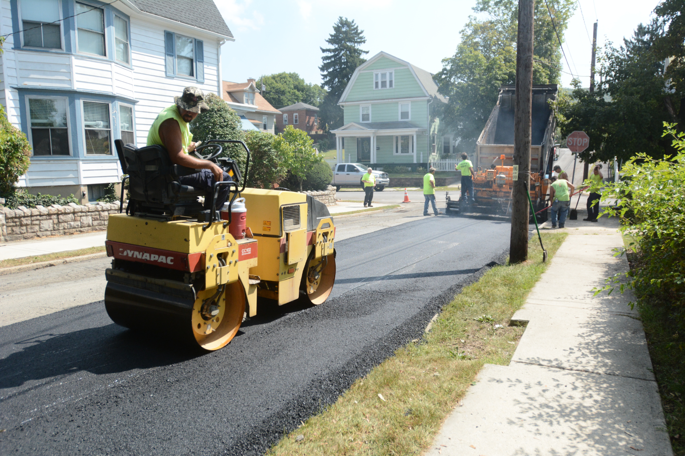
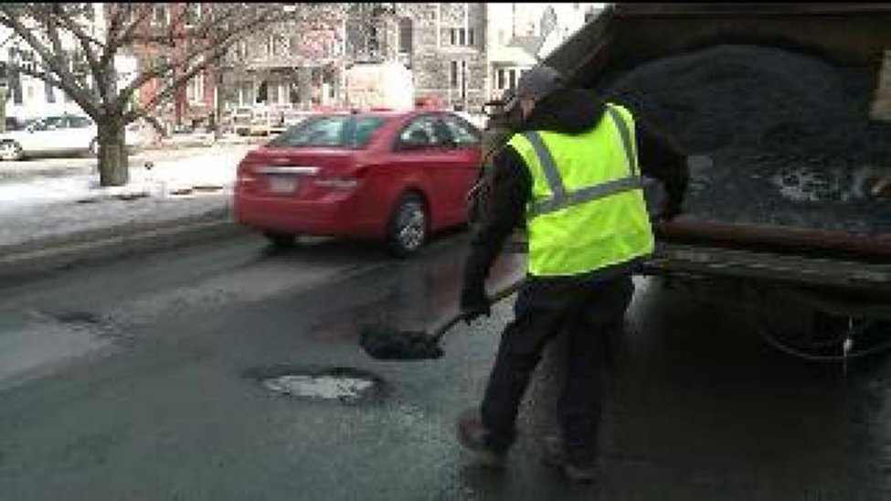
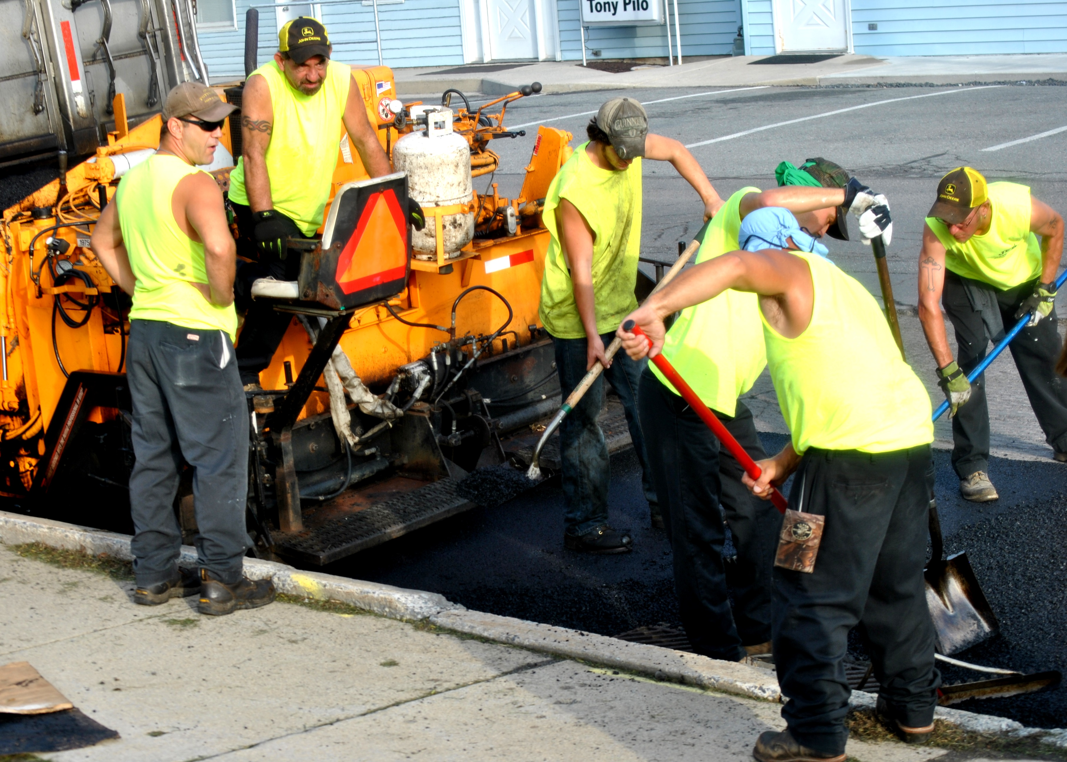
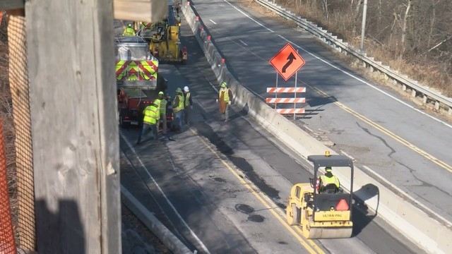
How do we respond?
Contracted paving
Pothole repair
City Paving
Pictures courtesy of the Republican Herald

Slide 16
Short Term Repairs
Report a Pothole via website, calls to the City, staff observations
Cold Patch
Concrete
Hot Macadam
Pothole Location Submission Form
Visit pottsvillepa.gov
Scroll to the bottom of the homepage
City Garage contact number: 570-622-7690

Slide 17
The Process
Creating a comprehensive Street Program requires the collection of detailed data regarding street inventory and repair history. Other items considered include:
Cost of Materials and Contracted Labor
In 2021 materials were $51 per ton – In 2022, materials will cost $61.70 per ton. In 2023, materials will cost $65 per ton.
citizen input
Staff & City Council Review of Data
Prioritize Streets based upon condition and use
Coordinate work with Utilities, business partners, community projects
Present proposed program to PennDOT
Create Bid Documents
Implement timeline

Slide 18
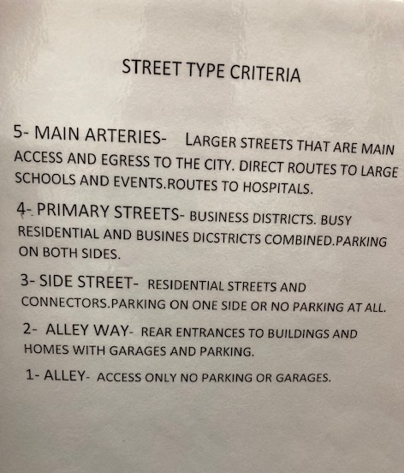
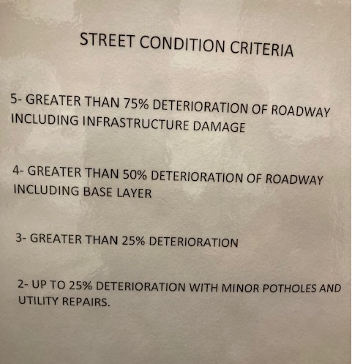
How Do We Rank Our Streets

Slide 19
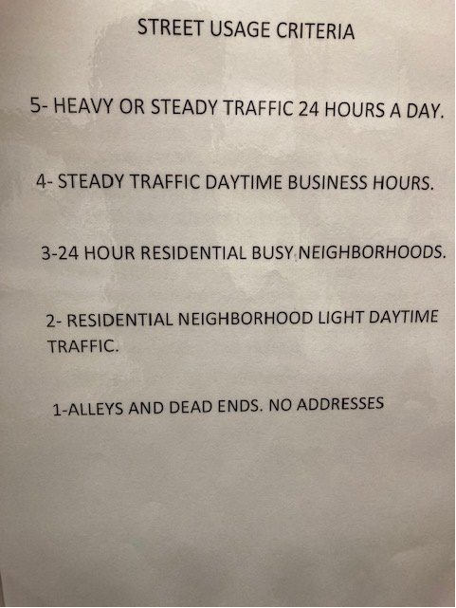

Slide 20
An Example of Our Spreadsheet
Street | Section | Street Type | Street Usage | Street Condition | Date of Last Major Repair | Type of Repair | Rank | Comments
Adams | Jackson to George | 3 | 2 | 0 |  |  | 5
Anderson | Mauch Chunk to Snyder | 4 | 4 | 4 |  |  | 12
 | Snyder to E. Norwegian | 4 | 3 | 3 |  |  | 10
Arch (East) | Center to Progress | 4 | 2 | 2 |  |  | 8
 | Progress to Rte. 61 |  |  |  |  |  |  | Complete
 | Rte. 61 to George | 5 | 4 | 5 | 2020 |  | 14 | Complete
 | George to Jackson | 4 | 3 | 3 |  |  | 10
 | Jackson to Wolf | 4 | 3 | 3 |  |  | 10
 | Wolf to Hospital | 3 | 3 | 2 |  |  | 8
Arch (West) | Center to 2nd | 3 | 3 | 2 |  |  | 8
 | 2nd to 3rd | 3 | 2 | 2 |  |  | 7
 | 3rd to 4th | 3 | 3 | Paved 2019 | 2019 | Resurfaced | 6 | UGI-Completed
 | 4th to 5th | 3 | 2 | 2 |  |  | 7
 | 5th to 6th | 3 | 2 | 2 |  |  | 7
 | 6th to 7th | 3 | 2 | 2 |  |  | 7
 | 7th to 8th | 3 | 2 | 2 |  |  | 7
 | 8th to 10th (Near Race) | 3 | 2 | 2 |  |  | 7
Aspen Lane | Off of Timber | 1 | 1 | 2 |  |  | 4
Atlantic Ave | E. Railroad to City Line | 2 | 2 | 2 |  |  | 6
Baber | Mauch Chunk to Washington | 2 | 2 | 2 |  |  | 6
 | Washington to Pulaski | 2 | 2 | 3 |  |  | 7
Bannon | 4th to Dead End | 2 | 2 | 3 |  |  | 7
Bastress | Off of 21st |  |  |  |  |  |  | Complete
Battery | 16th to Dead End | 2 | 2 | 2 |  |  | 6
Boone | 4th to Dead End | 2 | 2 | 3 |  |  | 7
Burd Alley | 7th to 8th | 2 | 2 | 4 |  |  | 8
Calvary | Hillside to Greenbriar | 2 | 2 | 2 |  |  | 6

Slide 21
2023 Proposed Paving Program Phase I
2nd Street- Market St. to Norwegian St.
Division St.- 3rd to 4th St.
Union St. & Progress Ave.- Intersection
South 4th St- Union St. to Pierce St.
North 8th St.- Harrison St. to Fairview St.
Mahantongo St.- 21st St. to 22nd St.
Railroad St.- Ravine St. to Heffner St.
9th Street- Mahantongo St to Howard Ave.
Young St.- Jefferson St. to Carbon St.
Woodglen Rd.- City line to previous pave
Laurel Blvd.- Progress Ave to Domino’s-1
Laurel Blvd.- Progress Ave to Domino’s-2
Anderson St.- Mauch Chunk to Snyder
Snyder- Anderson to Alley

Slide 22
2023 Street Department Project Timeline
Update, Compile, and Study Street Data Complete
Prioritize Streets based upon condition, use, and cost March, April 2023
Determine the extent of repairs on each prioritized area March 2023
Meet with PennDOT to develop Liquid Fuels Projects April 13, 2023
Infrastructure repairs / inlet replacement May – October 2023
Bid Materials and Labor April 2023
Award Bids May 2023
Initiate Pothole repair and paving project April –October
Complete Projects October 2023
Line Painting ongoing

Slide 23
Long Term Repairs
Include contract paving and paving completed by City Staff
In 2021, 2,000 tons of asphalt material was applied to City streets. This was an increase of 250 tons from 2020.
In 2022, 2,075 tons of asphalt were applied.
In 2023, Phase 1 paving will include 2,243 tons of asphalt material

Slide 24
2023 Summer Employment
The City of Pottsville is hiring:
Lifeguards
Concession/Counter
JFK Pool Maintenance
Street/Parks Laborer
Applications are available at City Hall-City Clerk’s Office, Online at pottsvillepa.gov
Application deadline is May 1, 2023

Slide 25
Garfield Square Redevelopment Project 402-406
RFP can be found on pottsvillepa.gov
SCHEDULE OF EVENTS
RSVP for Pre-Proposal Conference April 19th
Deadline for Re-Proposal questions April 19th
Pre-proposal conference April 25th
Proposals Due Date May 16th
review period begins May 17th
Presentations (if required) May 22nd – June 2nd
Estimated proposal selection date July 19th
Court Approval August 31st
Settlement with Buyer September 30th

